Slide 1
Introduction to Web Technologies
JS Logics, HTML functions
Lecturer: Christen Cao

Slide 2

Topic 5.1: Logical Operators

Slide 3
Summary
Logical operators &&, ||, !
Associativity, Distribution & DeMorgan Laws
Truth table
Operator precedence
Examples

Slide 4
Logical Operators
• and (&&), or(||) and not (!)
operands are logical values : true, false
can be used to make more advanced tests for use in
conditionals and iteration.
Enter a number, output message if it is between [2,4]
(2,4] (2,4)
var x=Number(prompt("enter a number: "));
alert( x>=2 && x<=4 );
console.log(x<2 || x>4)

Slide 5
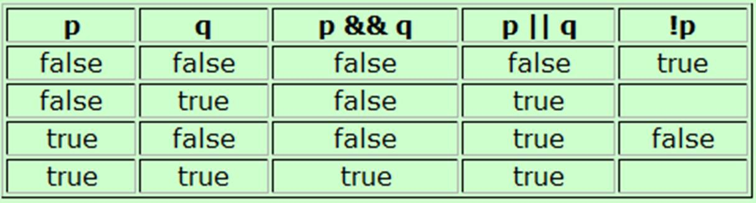
Truth Table
A chart showing the results of a logical operator for all
possible values of its operands.
p&&q is only true, if both its operands are true
p||q is true, if either of its operands are true
alert( true && false );
alert( true || false );
Notes:
CODE THIS

Slide 6
Logical Operator Rules
Associativity:
– p&&q == q&&p,
– p||q == q||p
just as x*y =y*x ; x+y = y+x
Distribution
– p && ( q || r ) == (p&&q) || (p&&r)
Just as x*(y+z) = x*y + x*z
– p || ( q && r ) == (p||q) && (p||r)
DeMorgan special rules
– !(p&&q) == !p || !q
– !(p||q) == !p && !q

Slide 7
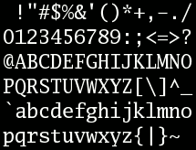
ASCII character
95 printable characters (codes 32 to 126)
start with "space" at 32
decimal digits 0-9 start at 48
26 upper case letters A-Z start at 65
26 lower case letters a-z start at 97
For this course, we will not test/going thru ASCII, good to know
Computer only understands numbers, so we represent ch with numbers
Notes:
For this course, we will not test/going thru ASCII, good to know
Computer only understand numbers, so we represent ch with numbers

Slide 8
Try out: logical operators
Determine whether a character is lower case, letter, digit, vowel:
var c=prompt("enter a character:");
if( c>="a" && c<="z" )
alert("lower case letter");
if( c>="a" && c<="z" || c>="A" && c<="Z")
alert("letter");
if( "0"<=c && c<="9" )
alert("digit");
if( c=="a" || c=="e" || c=="i" || c=="o" || c=="u" ) alert("vowel");

Slide 9
Topic 5.2: Programmer-defined Function

Slide 10
Summary
Programmer-defined Function
Function declaration, call, returns
Formal/actual parameters
Variable scope: global vs local
HTML Form Elements
HTML with JavaScript (User interaction)

Slide 11
Built-in Function
alert(string parameter)
prompt()
number(…), parseInt(…)
Associated with objects:
String obj: s.indexOf(…), s.substr(…,…), s.substring(…,…), s.charAt(…), s.toUpperCase(), s.toLowerCase(), …
Math obj: Math.round(…), Math.floor(…), …
Notes:
The parseInt() function parses a string argument and returns an integer

Slide 12
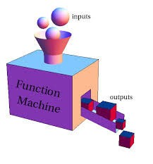
Programmer-defined function
more readable
less error prone
re-usable
Declare a function:
function identifier(parameter1, parameter2, …)
{
statement1 ; statement2 ;
….
}

Slide 13
A Simple Function
A simple function with one statement and no parameter
function dosth() { // declare a function alert("doing sth");
}
dosth(); // Calling a function:
Notes:
CODE THIS!

Slide 14
Function Declaration/Call
var v="a", w="b";
function f1(){v+="c"; w+="d";} // declaration function f2(){v+="e"; w+="f";} // declaration
f1(); f2();
alert("v="+v+";w="+w);
// call function
// v=ace;w=bdf
v="a"; w="b"; f2(); f2(); f1();
alert("v="+v+";w="+w);
// v=aeec;w=bffd

Slide 15
Two main flavours of functions
Get the job done :
function destroyUniverse() { alert(“destroyed!”);
};
Produce a return value: function getSomething() {
var answer = prompt("Enter something:"); return answer;
};
Notes:
CODE RETURN VALUE

Slide 16
Return result
when returning values:
add a return statement inside the function, signal a result of a function
the call of the function is now placed in a position where a value is expected
var sth=getSomething(); alert(sth);
or alert(getSomething());

Slide 17
Parameters
hardcoded values ☹
var a = 10, b = 5;
function add() {
var c=a+b;
return c;
}
To make the function more general, we use parameters:
function add(a, b) {
var c=a+b;
return c;
}
alert(add(5,10));
var x=8; y=-20; alert(add(x,y));
alert(add("hello ", "world"));

Slide 18
Formal & Actual Parameters
Formal parameters
Parameters in the declaration of the function
Actual parameters
Parameters in the call of the function to replace the formal parameters
function add(a, b) { return a + b;
}
var n1 = 10;
var n2 = 2;
add(n1, n2);
add(4, 2);

Slide 19
Topic 5.3: HTML Form Elements

Slide 20
Button: onclick event
An event handler for a button can be implemented by Javascript as the value of the onclick attribute
<form>
<input type='button' value='clickme' onclick='alert("Hi");' />
</form>
Notes:
CODE THIS

Slide 21
JS Function
Declaring a JS function:
function identifier(parameter1, parameter2, …)
{
statements ;
…. return x;
}

Slide 22
Function call
Place longer scripts in the head of the document as a function(s)
Enclosed in <script>...</script>,
Event handler becomes a function call.
<script
type='text/javascript'> function doit(){ alert(‘Hi');
}
</script>
……
<form>
<input type='button' value='clickme' onclick='doit();' />
</form>
Notes:
CODE THIS

Slide 23
Function call with parameters
<script
type='text/javascript'> function doit(v){ alert(v)
}
</script>
……
<form>
<input type='button' value='clickme' onclick='doit(“done”);' />
</form>
Better to use variables as function parameters !
<input> event handler
– onmouseup, onclick, onchange
Notes:
CODE THIS

Slide 24
onchange & this.value
onchange: when text is changed & the box loses focus
this: pseudo-variable to address current object
<form>
<input
type='text' onchange='alert(this.value);' />
<textarea onchange='alert(this.value);'>
</textarea>
</form>
Notes:
CODE THIS

Slide 25
Addressing in DOM
document.form_name.element_name
hierarchy of objects in Document Object Model (DOM)
a button belongs to a form, a form belongs to a document
document.getElementById(element_id)

Slide 26

Addressing
<html>
<head>
<script type='text/javascript'> function f(v){
document.getElementById("text2").value =v.toUpperCase();
}
</script>
</head>
<body>
<form name='form1'>
<input type='text' name='text1' />
<input type='text' id='text2' />
<input type='button' value='upperCase' onclick='f(document.form1.text1.value);' />
<input type='button' value='copyme' onclick='f(this.value);' />
</form>
</body>
</html>

Slide 27
Self Reading below

Slide 28
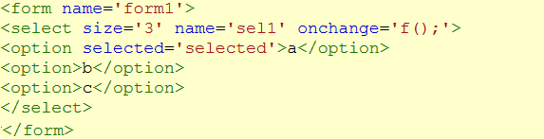

<select> menu
– <select> ... </select>
<select size=‘3' name='sel1' onchange='f();' >
<option> …. </option>
<option selected='selected'> … </option>
selectedIndex
•zero-based index of the currently selected item document.form1.sell.selectedIndex

Slide 29

Checkboxes
<input type='checkbox'... />
each checkbox is an independent choice
if a checkbox is selected, then its checked attribute value is ‘true’
<input type='checkbox' name='cb1' value='sugar' checked = 'true' />

Slide 30

Radio button
One-out-of-n choice
<input type='radio' ... />
<input type='radio' name='rad1' value='water' checked='checked' />

Slide 31
Practice Copying text (1)
Make b1 copy from text1 to text2 but changing the text to lowercase.
Make b2 copy from text1 to text2 but changing the text to uppercase.

Slide 32
Practice Copying text
<body>
<p> 2 text entry elements with 2 buttons</p>
<form name='form1’>
<input type='text' name='text1' />
<input type='button' value='b1' onclick='f("lower");' />
<input type='text' id='text2' />
<input type='button' value='b2' onclick='f("upper");' />
</form>
</body>

Slide 33
Practice Copying text
<head>
<script type='text/javascript’> function f(caps){
if(caps=="upper"){ document.getElementById("text2").value
=document.form1.text1.value.toUpperCase();} if(caps=="lower"){ document.getElementById("text2").value
=document.form1.text1.value.toLowerCase();}
}
</script>
</head>

Slide 34

Practice changeCase
Write a changeCase form which has two text boxes and a select menu. The menu has three options (copy, uppercase, lowercase). After text
is entered, and a menu option selected, the text is copied to the second textbox (or made uppercase or lowercase) according to the menu choice.

Slide 35
<Happy coding, everyone!/>
<Thank you!/>

